Slide 1

Year 3: Boudicca
National Curriculum: British resistance, for example, Boudica

Slide 2
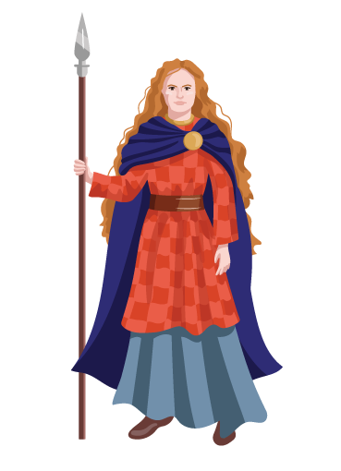
Ask Holly
Who is this? What questions do you have?

Slide 3
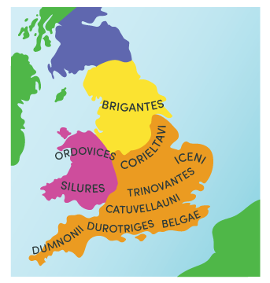
Who was Boudicca?
Boudicca was Queen of the Iceni tribe, a Celtic tribe in the area we now call East Anglia.
Holly’s Discoverer Fact: The Iceni were one of around 20-30 Celtic tribes when Boudicca was living!
Learn with Holly

Slide 4
When was Boudicca around?
Boudicca lived between 25AD and around 61AD.
We know about Boudicca because of historical artefacts that we have. Whilst there is no physical evidence of Boudicca herself, written accounts by Roman historian Tacitus and Cassius Dio tell us about her. This extract is from Cassius Dio’s writing (he was born 100 years after her death though!)
In stature she was very tall, in appearance most terrifying, in the glance of her eye most fierce, and her voice was harsh; a great mass of the tawniest hair fell to her hips; around her neck was a large golden necklace; and she wore a tunic of divers colours over which a thick mantle was fastened with a brooch. This was her invariable attire.
Learn with Holly

Slide 5
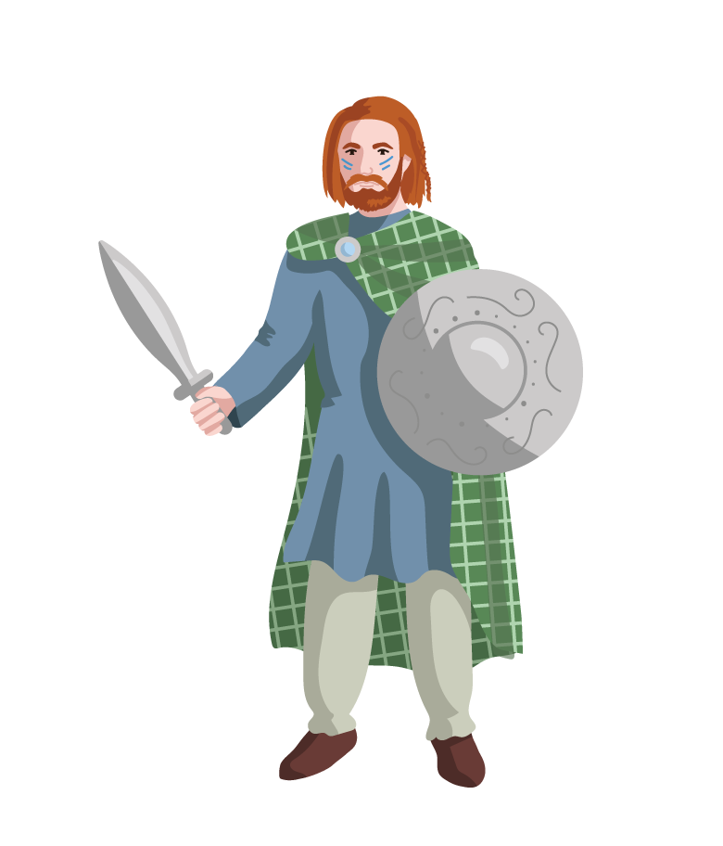
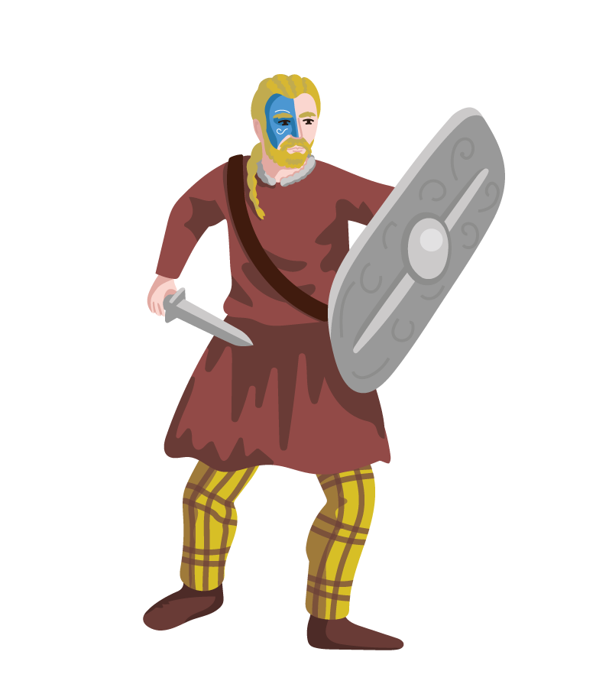
What did Boudicca do?
Her husband, who was King, had made a promise with the Romans to keep his Celtic people safe. When her husband died, the Romans did not keep their word and treated the Iceni people very badly.
Boudicca was not happy about her people being treated so badly and decided to fight back. She gathered with the Iceni people and surrounding tribes to resist the Roman invasion.
Holly’s Discoverer Fact: The Iceni people often painted their skin with blue paint to look more intimidating!
Learn with Holly

Slide 6
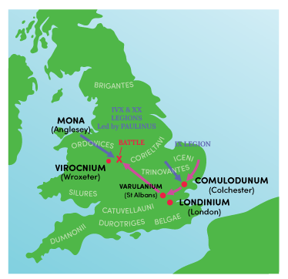
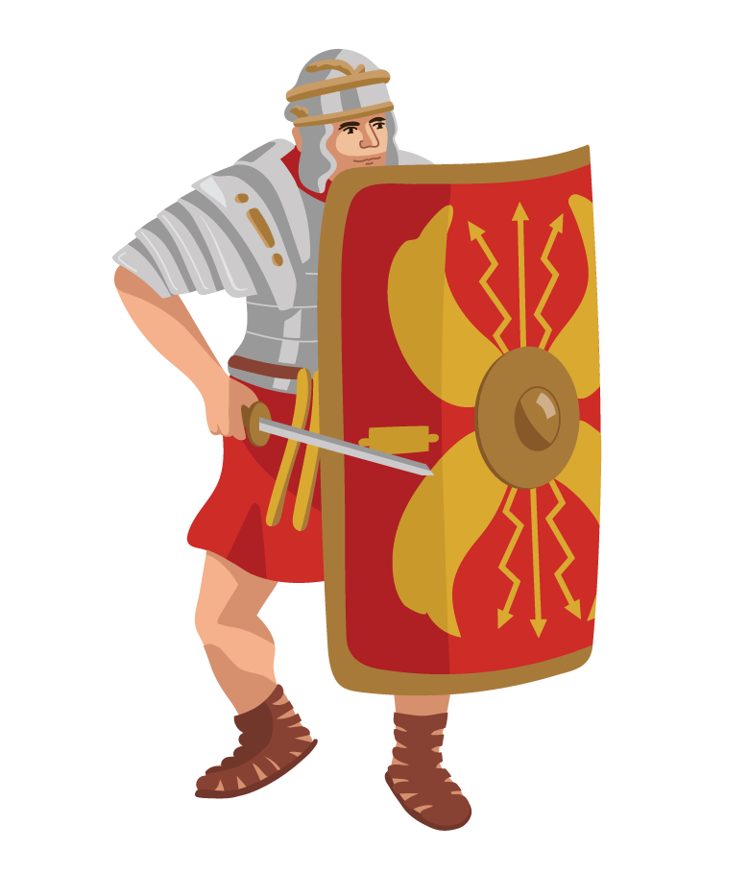
Where did Boudicca go?
Boudicca and her army fought back against the Romans. They conquered Colchester, Londinium and St Albans.
Boudicca and her warriors
Roman army
Holly’s Discoverer Fact: Londindium is what the Romans called London!
Learn with Holly

Slide 7
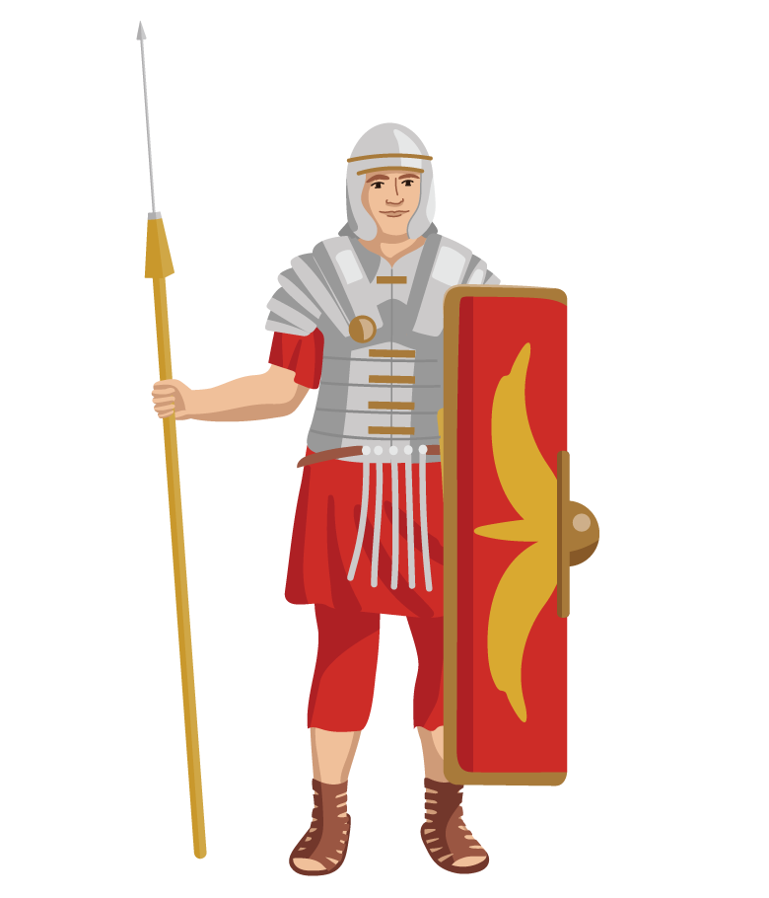
What happened to Boudicca?
The Romans were fighting other battles in North Wales (Anglesey). Upon hearing about Boudicca’s rebellion, the Roman army decided to confront her and her warriors.
The Battle of Watling Street took place in 61AD. Boudicca and her army were defeated by the Roman soldiers.
Holly’s Discoverer Fact: After Boudicca’s defeat, there were no more large rebellions in Southern England against the Romans.
Learn with Holly

Slide 8

Why was Boudicca defeated?
There are many reasons that historians think Boudicca lost against the Romans. Which do you think is the most significant?
Supplies
Boudicca’s army faced a lack of supplies.
Location
Watling Street was better for the Roman army’s tactics – they could fight on this narrow location! It was chosen by Roman commander Gaius Suetonius Paulinus.
Overconfidence
Boudicca’s army was much larger than the Romans (about 120 000 – 230 000, so they thought they would win.
Roman Army Discipline
The Roman army was better organized and established compared to the Britons – even though the Britons outnumbered them!
Holly’s Discoverer Fact:
80 000 Britons were killed compared to around 400 Romans!
Learn with Holly

Slide 9
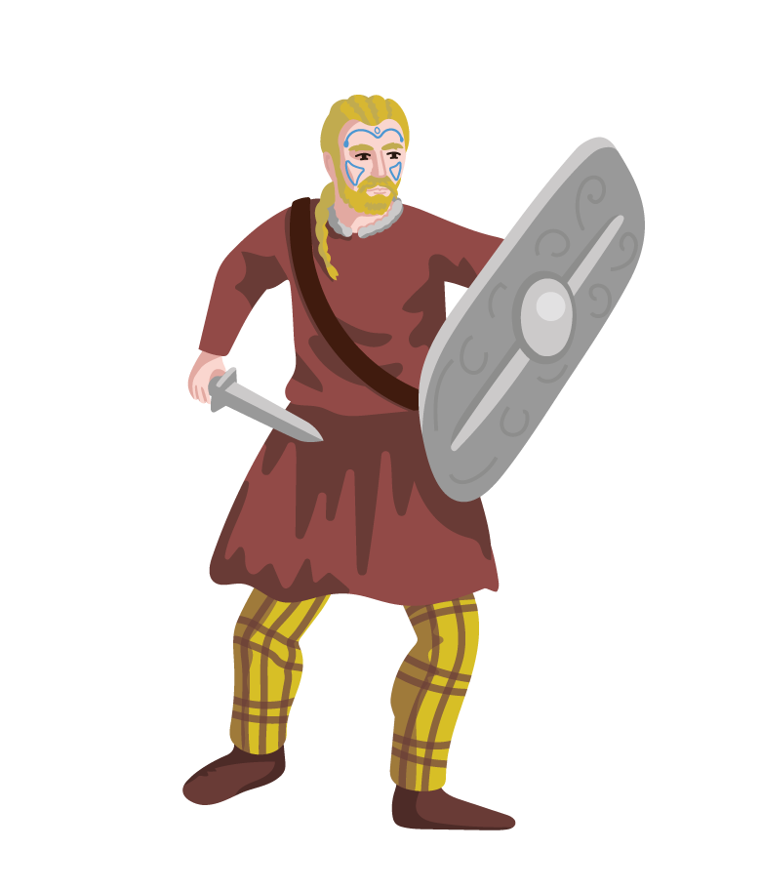
Practise with Holly
Work in partners. Choose one of the characters below while the other partner is an interviewer. Use the questions below to interview your historical figure!
Iceni Warrior
Boudicca
Roman Soldier

Slide 10
Independent Discoverers
Create a factfile about Boudicca.
What?
Who?
When?
Where?
How?
Why?

