Slide 1

Year 1: 7 Continents
National Curriculum: Locational Knowledge: name and locate the 7 continents

Slide 2
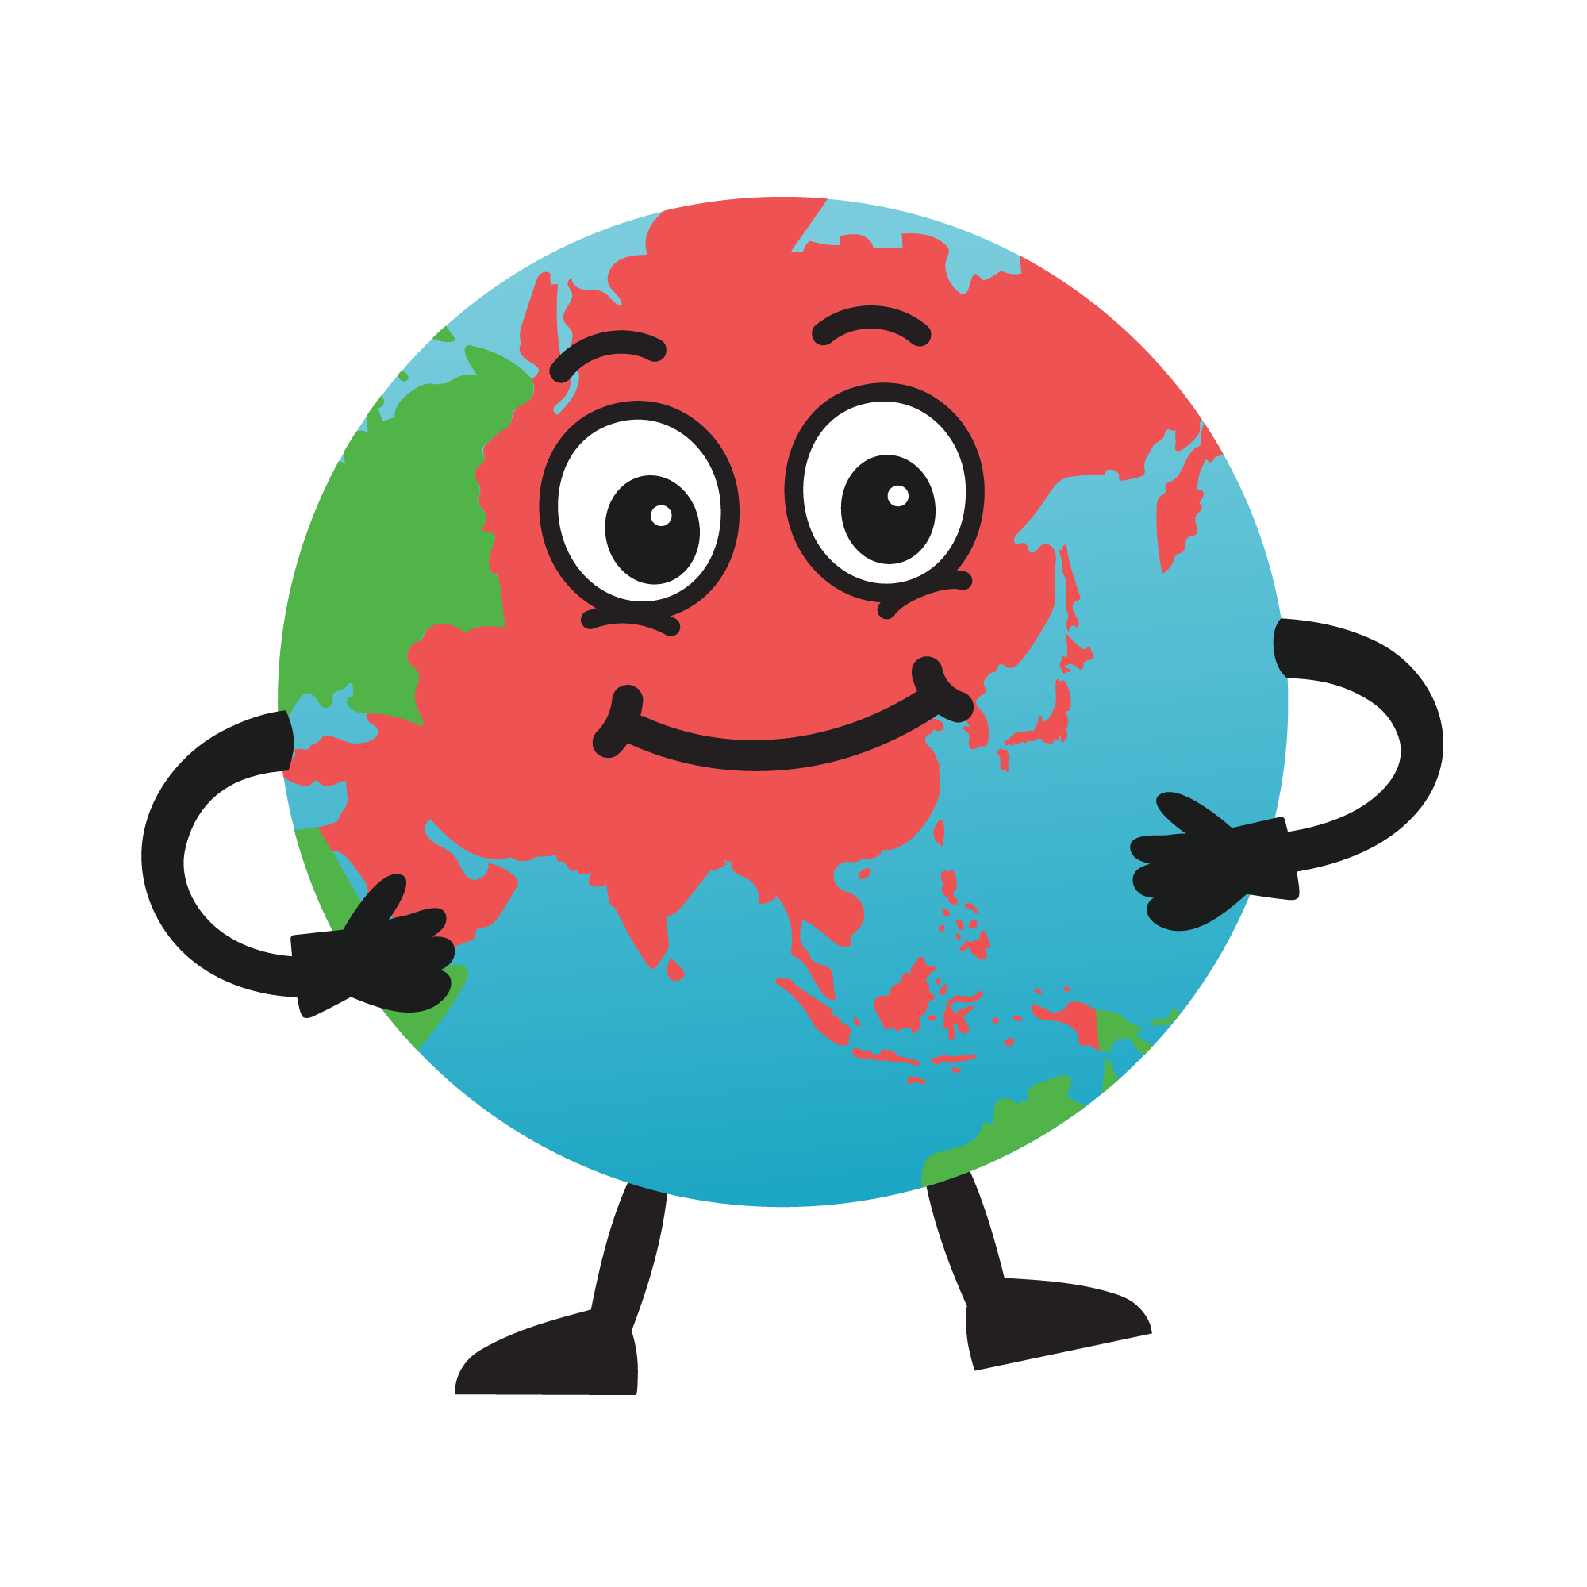
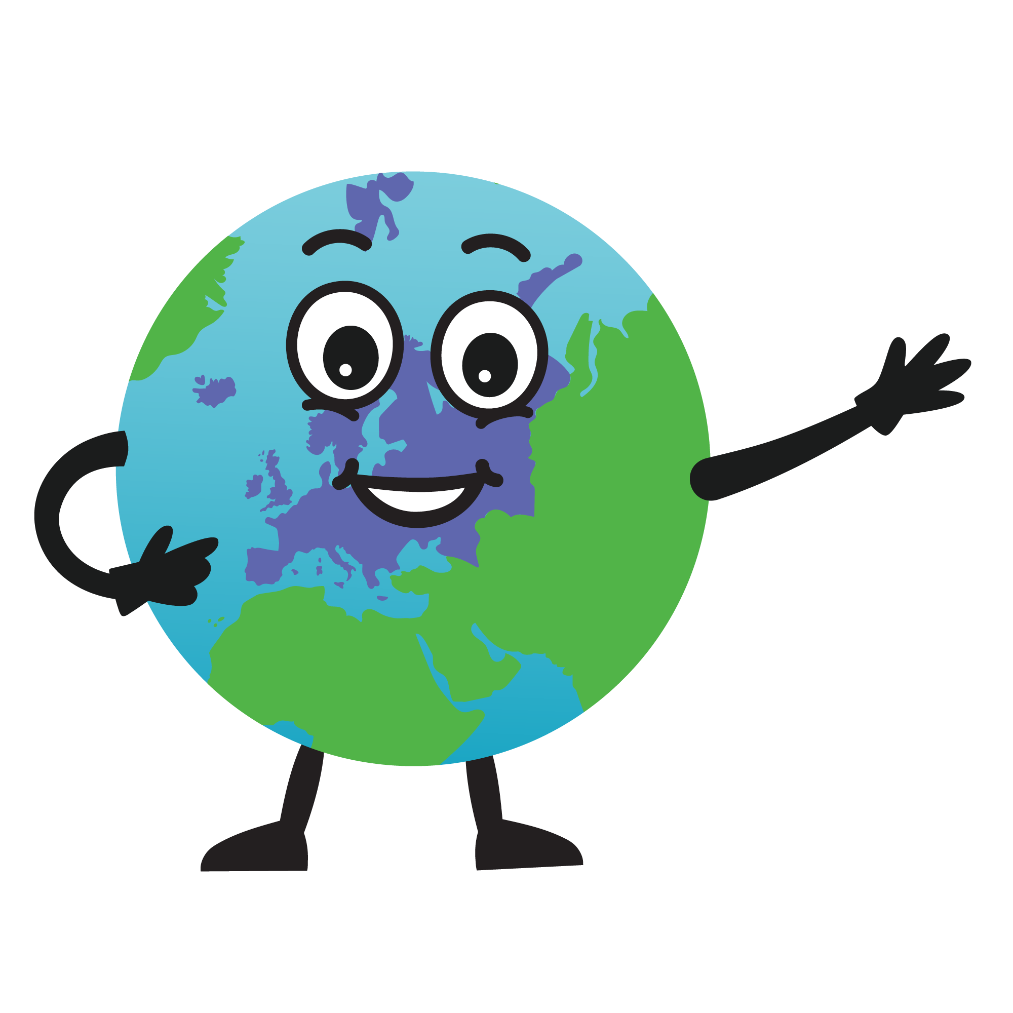
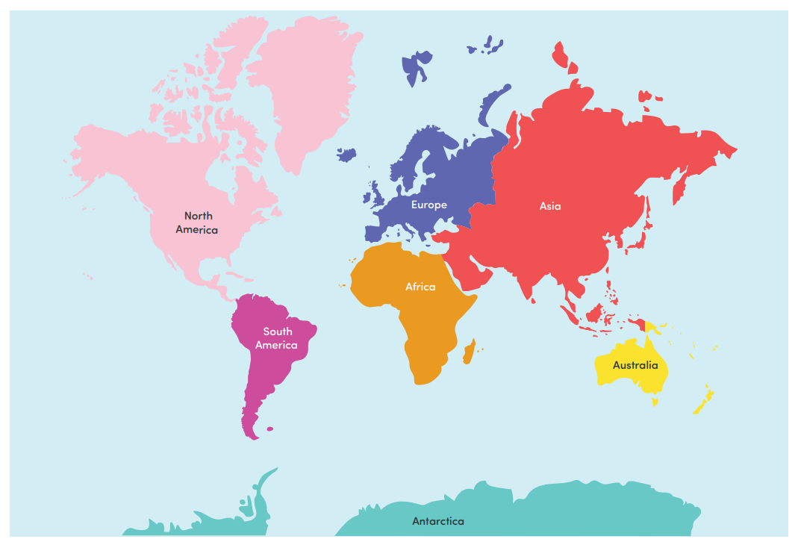
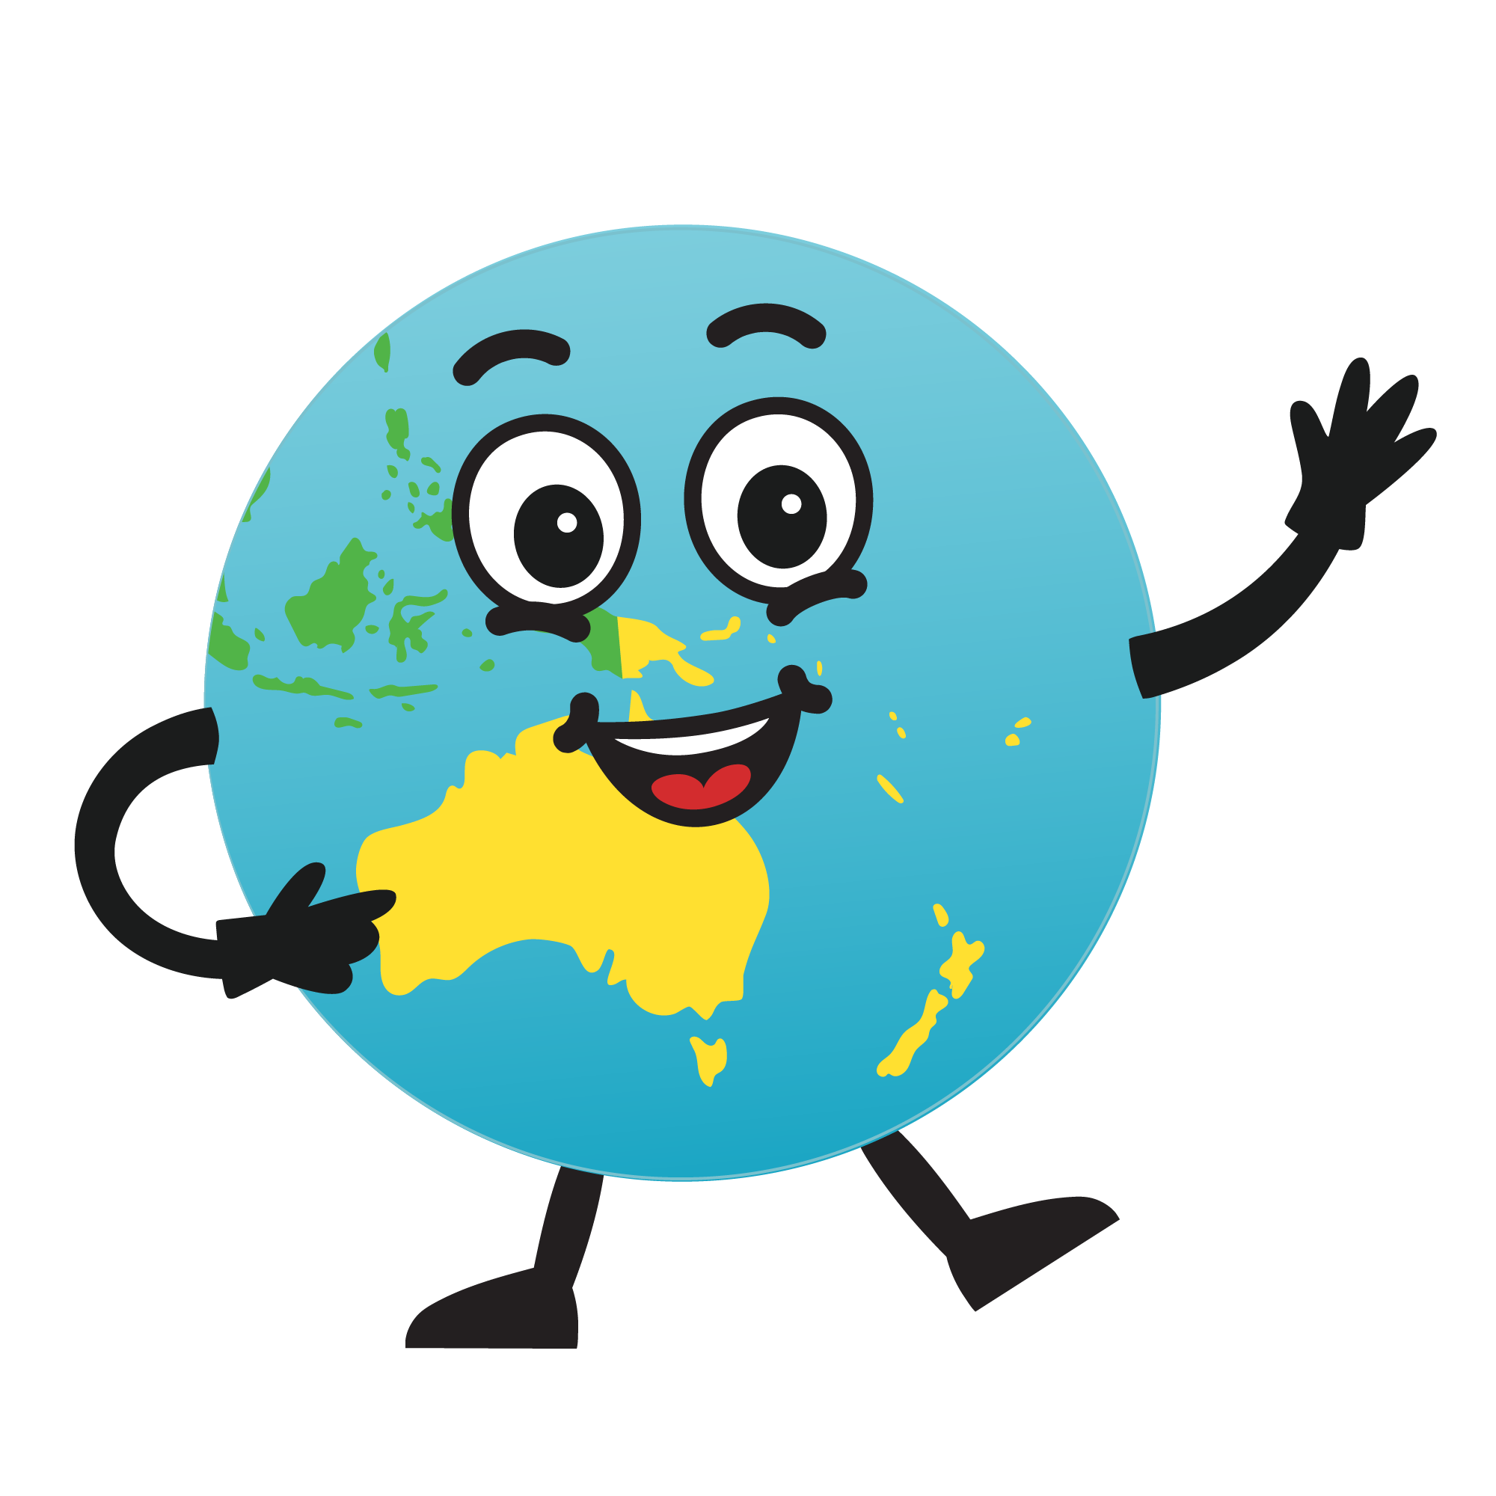
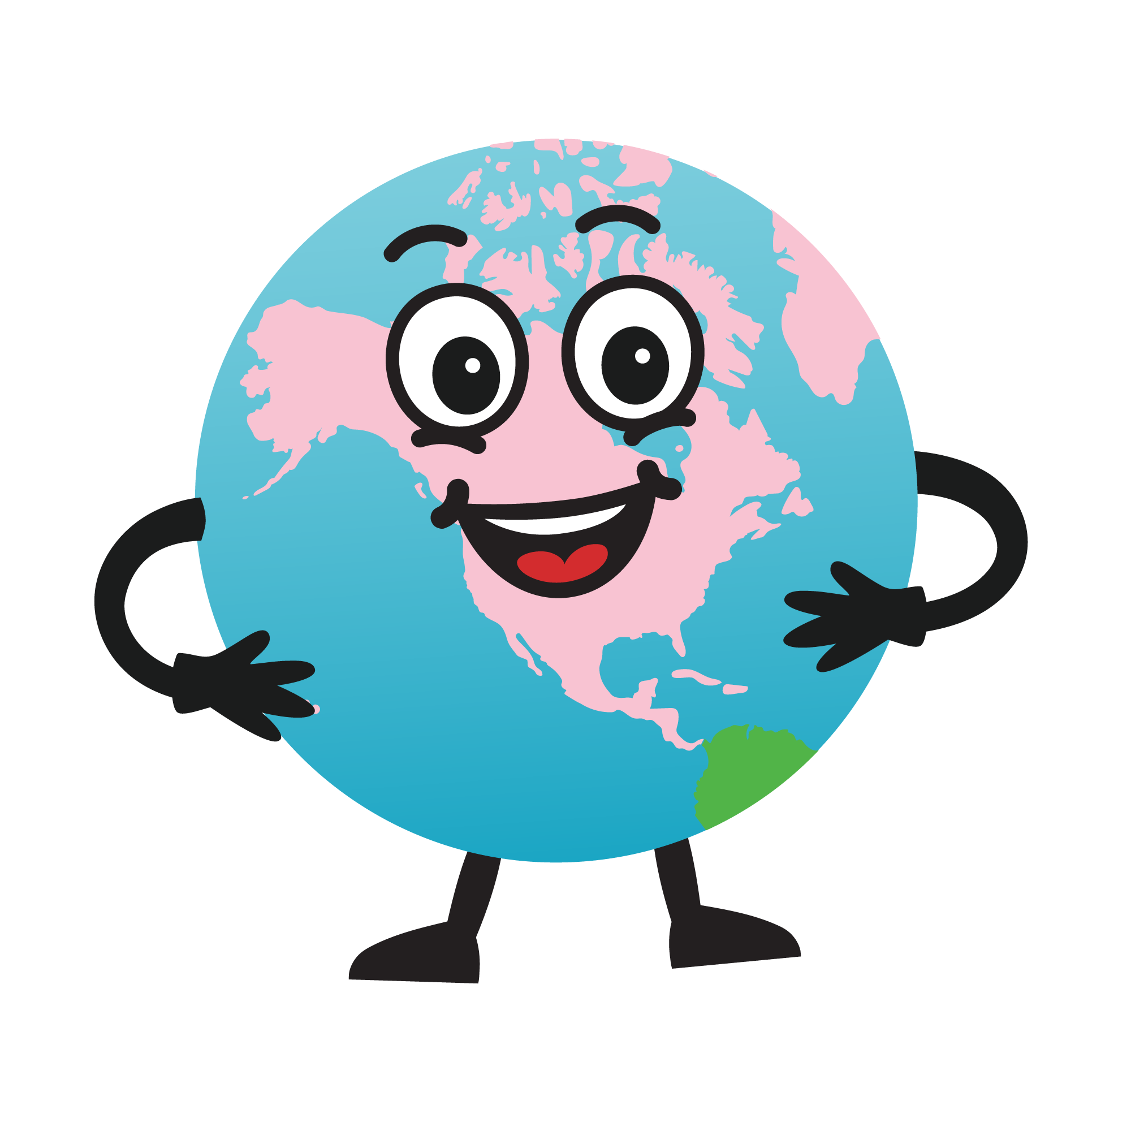

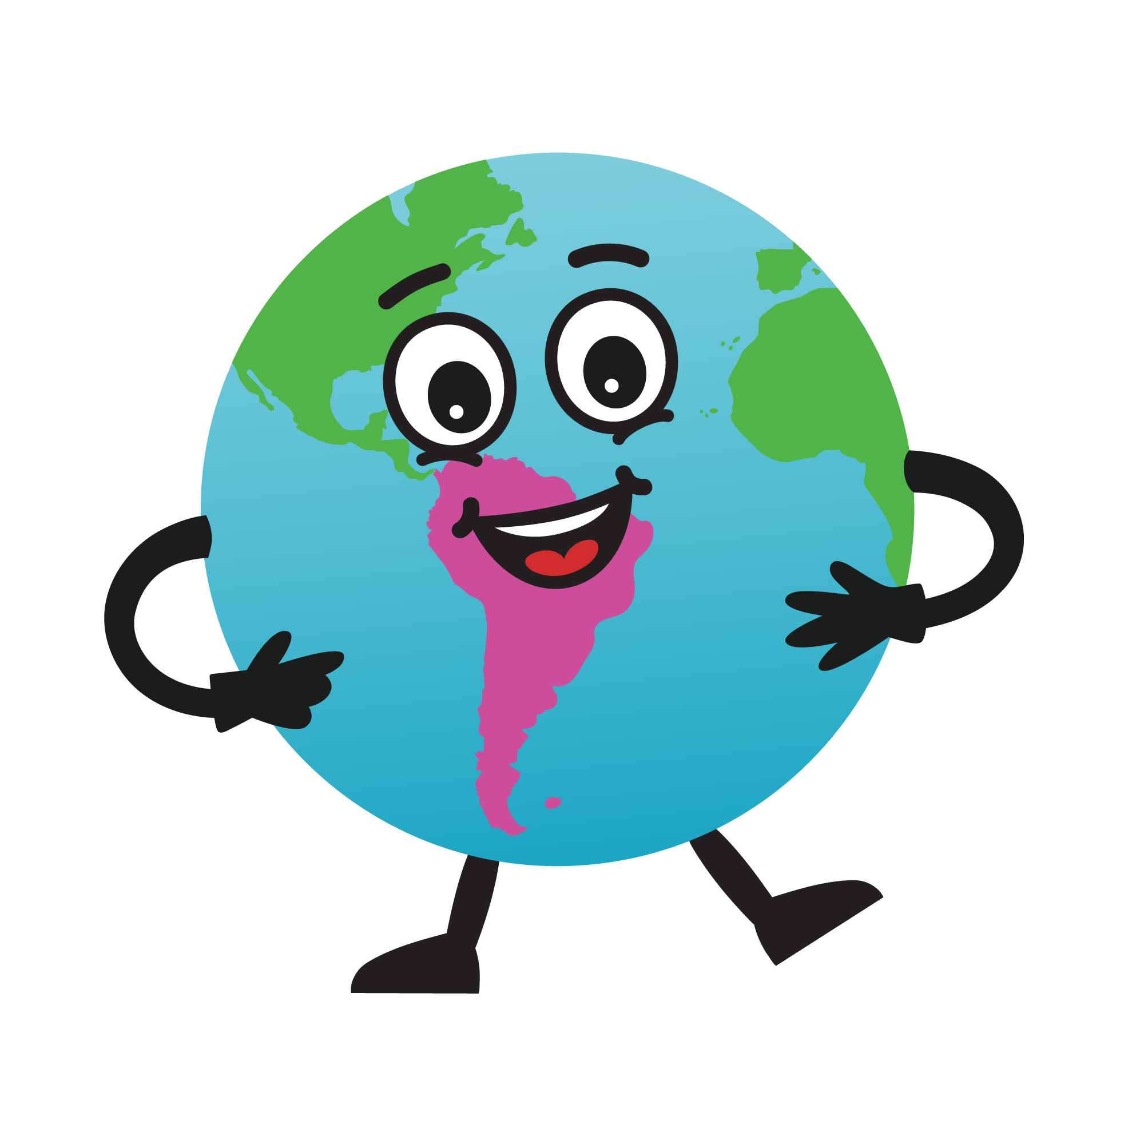

Ask George
What do you know? What questions do you have?

Slide 3
Europe
Countries: UK, France, Italy, Germany
Hot or cold: A mix!
Cities: London, Paris, Rome, Berlin
George’s Explorer Fact: There are 44 countries in Europe!
Learn with George

Slide 4
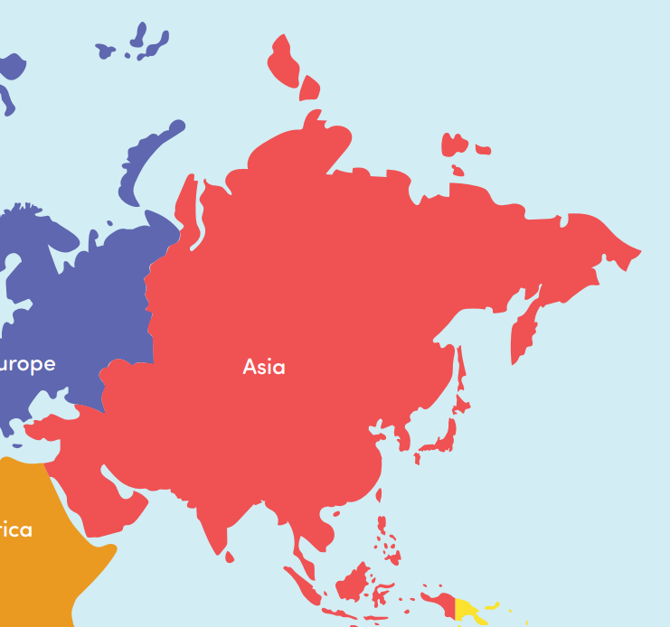
Asia
Learn with George
Countries:
China, India, Bangladesh
Cities:
Beijing, Tokyo, Mumbai
Hot or cold: hot!
George’s Explorer Fact: More than 2000 languages are spoken in Asia!

Slide 5
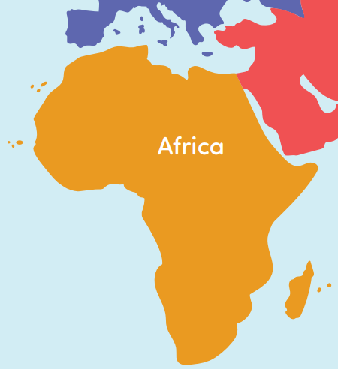
Africa
Countries: Egypt, Kenya, Botswana
Hot or cold: hot!
Cities: Cairo, Nairobi, Gaborone
George’s Explorer Fact: The hottest temperature record in Africa was 55 degrees Celsius in 1931!
Learn with George

Slide 6
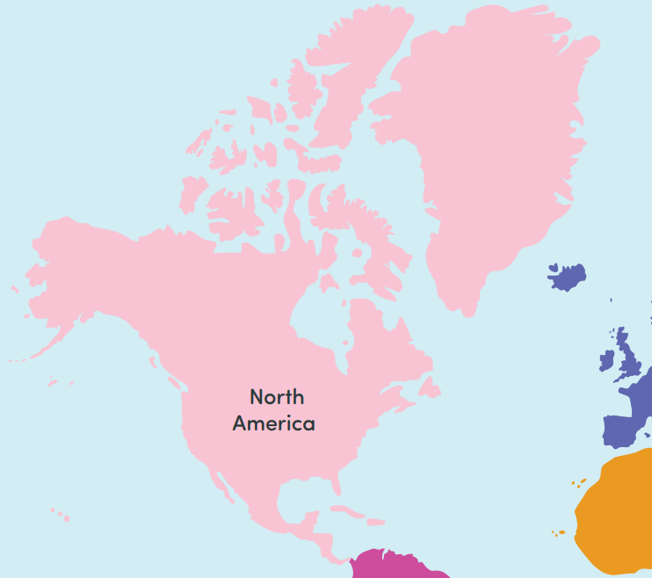
Learn with George
North America
Countries: USA, Canada, Greenland
Hot or cold: A mix!
Cities: New York, Toronto, Nuuk
George’s Explorer Fact: The USA is split into 50 states!

Slide 7
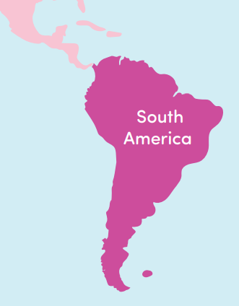
South America
Learn with George
Hot or cold: hot!
Countries: Brazil, Argentina, Peru
Cities: Rio de Janeiro, Buenos Aires, Santiago
George’s Explorer Fact: The Amazon rainforest is the biggest in the world!

Slide 8
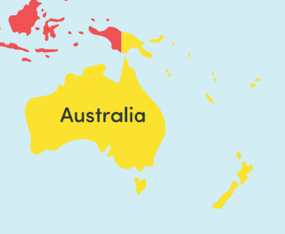
Australasia/Oceania
Hot or cold: hot!
Countries: Australia, New Zealand, Papua New Guinea
Cities: Sydney, Auckland, Port Moresby
George’s Explorer Fact: Most of Australia’s population live near the coast – 85%!
Learn with George

Slide 9

Antarctica
Learn with George
Countries: None
Hot or cold: Very cold!
Cities: None
George’s Explorer Fact: There are no countries or cities in Antarctica but over 50 countries have research stations there!

Slide 10
Practice with George
Can you say the name of each continent and match it to its location on the map?

Slide 11

Independent Explorers

